Slide 1
Comparing representations of outcomes for two events
Probability: possible outcomes

Slide 2
How our teaching resources are designed for the classroom

Slide 3
I can identify the same outcome across all the different representations.

Slide 4
An outcome table is a table that shows all the possible outcomes.
Tree diagrams are a representation used to diagram statistical/probability questions. Branches represent different possible events or outcomes.
Venn diagrams are a representation used to diagram statistical/probability questions. Commonly circles are used to represent events.
Each branch of an outcome tree shows a possible outcome from an event or from a stage of a trial. The full outcome tree shows all possible outcomes.

Slide 5

Comparing representations of outcomes for two events
Transferring information between diagrams
Using multiple diagrams

Slide 6
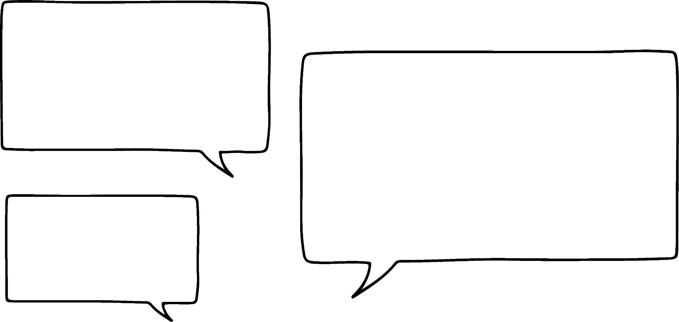

Transferring information between diagrams
Starters
Tomato Soup (T)
Garlic Bread (G)
Mains
Pasta Carbonara (P)
Fish Pie (F)
Spinach Gnocchi (S)
I’m able to take information about the stages of an event, like choosing a starter and main course from a menu…
Jun
Jun will choose a starter and a main course.
What are the possible outcomes of their selection?

Slide 7
Transferring information between diagrams
Starters
Tomato Soup (T)
Garlic Bread (G)
Mains
Pasta Carbonara (P)
Fish Pie (F)
Spinach Gnocchi (S)
TP
TF
TS
GP
GF
GS
And list out all the possible outcomes,
or place them in an outcome table,
or in an outcome tree…
sample space
P
TP
TF
TS
GP
GF
GS
Jun
T
F
 | P | F | S
T | TP | TF | TS
G | GP | GF | GS
S
P
G
F
S

Slide 8

Transferring information between diagrams
I think so.
You can use the headers of an outcome table to tell you the menu items.
For example…
But is it possible to use one diagram to finish a different one that isn’t completed, without the actual menu to help us?
TP
TS
GF
Jun
Sofia
 | P | F | S
T | TP | TF | TS
G | GP | GF | GS
FP

Slide 9
Transferring information between diagrams
And these headers on the second layer of branches.
I know this because there are three branches and three headers.
Cool!
So I can use these headings on the first layer of branches…
That’s right!
Now your outcome tree is full, you can complete the sample space, too.
These headers tell you the starters,
whilst these headers tell you the mains.
P
TP
TS
GF
Jun
Sofia
T
F
TF
 | P | F | S
T | TP | TF | TS
G | GP | GF | GS
S
P
GP
G
F
S
GS

Slide 10

Transferring information between diagrams
A coin will be flipped and a spinner will be spun.
The outcome table and outcome tree both show the same trial.
What would go in the two gaps on the outcome tree?
heads
 | 1 | 7 | 9
heads | h1 | h7 | h9
tails | t1 | t7 | t9
a
9
tails
b
The heads and tails can go either way around.

Slide 11
Transferring information between diagrams
A coin will be flipped and a spinner will be spun.
The outcome table and outcome tree both show the same trial.
What would go in the two gaps on the outcome tree?
1
a
h
7
 | 1 | 7 | 9
heads | h1 | h7 | h9
tails | t1 | t7 | t9
b
9
t
The 1 and 7 can go either way around.

Slide 12
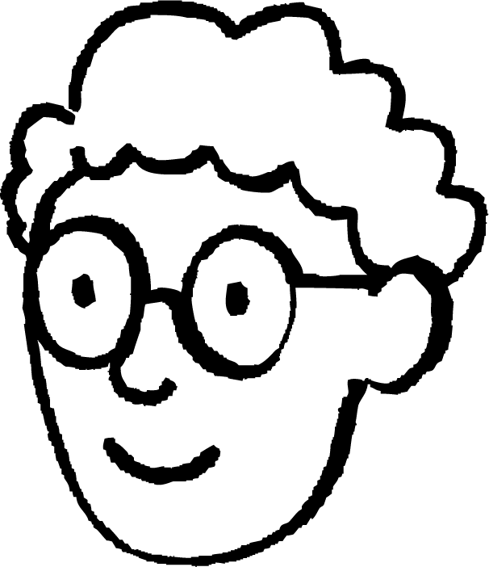
Transferring information between diagrams
It is possible to use one correct diagram to check the errors of a different, incorrectly completed one.
ξ
Alex will spin a spinner with outcomes:
{1, 2, 3, 4, 6, 7, 9, 10}
even
factor
of 18
Alex
4
6
9
Alex considers the event that the spinner lands on an even number and the event it lands on a factor of 18.
Alex shows these events correctly on this Venn diagram.
2
10
3
1
7

Slide 13
Transferring information between diagrams
Alex will spin a spinner with outcomes:
{1, 2, 3, 4, 6, 7, 9, 10}
factor of 18
even
2, 4, 8
not factor of 18
10
Jun will spin the same spinner as Alex, but shows the events of the trial on an outcome tree.
factor of 18
odd
1, 3, 6, 9
not factor of 18
7
Jun

Slide 14
Transferring information between diagrams
ξ
factor of 18
even
factors
of 18
even
2, 4, 8
6
not factor of 18
4
9
10
2
10
3
factor of 18
odd
1
1, 3, 6, 9
7
not factor of 18
7
Alex’s Venn diagram is fully correct, whilst Jun’s outcome tree is not.
By comparing the two diagrams, find Jun’s three errors.
Alex
Jun

Slide 15
Transferring information between diagrams
ξ
factor of 18
even
factors
of 18
even
2, 4, 8
6
not factor of 18
4
9
10
2
10
3
factor of 18
odd
1
1, 3, 6, 9
7
not factor of 18
7
6 is even, not odd.
8 isn’t a factor of 18, and wasn’t an outcome of the spinner.
Alex
4 is even but it isn’t a factor of 18.
Jun

Slide 16
Transferring information between diagrams
ξ
factor of 18
even
factors
of 18
even
2, 6
6
not factor of 18
4
9
4, 10
2
10
3
factor of 18
odd
1
1, 3, 9
7
not factor of 18
7
Jun has corrected the outcome tree.
All outcomes are in the correct location.
Alex
Jun

Slide 17
Transferring information between diagrams
Andeep will roll a dice with integers from 20 to 29 on it.
Andeep and Laura look at the events that the dice lands on an odd number and a multiple of 7.
Andeep correctly shows the outcomes of these events on an outcome table, but Laura makes three mistakes in her Venn diagram.
Which outcome on the Venn diagram should not be on the diagram at all?
 | multiple of 7 | not multiple of 7
odd | 21 | 23, 25, 27, 29
even | 28 | 20, 22, 24, 26
ξ
odd
multiple of 7
23
25
21
27
14
28
29
20
22
24

Slide 18
Transferring information between diagrams
Andeep will roll a dice with integers from 20 to 29 on it.
Andeep and Laura look at the events that the dice lands on an odd number and a multiple of 7.
Andeep correctly shows the outcomes of these events on an outcome table, but Laura makes three mistakes in her Venn diagram.
Which outcome on the Venn diagram is in the wrong place?
 | multiple of 7 | not multiple of 7
odd | 21 | 23, 25, 27, 29
even | 28 | 20, 22, 24, 26
ξ
odd
multiple of 7
23
25
21
27
28
29
20
22
24

Slide 19
Transferring information between diagrams
Andeep will roll a dice with integers from 20 to 29 on it.
Andeep and Laura look at the events that the dice lands on an odd number and a multiple of 7.
Andeep correctly shows the outcomes of these events on an outcome table, but Laura makes three mistakes in her Venn diagram.
Which outcome on the Venn diagram is missing?
 | multiple of 7 | not multiple of 7
odd | 21 | 23, 25, 27, 29
even | 28 | 20, 22, 24, 26
ξ
odd
multiple of 7
23
25
21
27
28
29
26
20
22
24

Slide 20
Transferring information between diagrams
1) Jacob and Laura submit homework for showing the outcomes of two events from a trial using different representations.
Use Jacob’s correctly written outcome table to circle any errors in the outcome tree and write down what is wrong with the outcome tree.
1, 3
 | factor of 45 (F45) | not factor of 45
prime | 3, 5 | 7, 23
not prime | 1, 9, 15, 45 | 12
F45
prime
not F45
5, 23
9, 15, 45
not prime
F45
not F45
12, 21

Slide 21
Transferring information between diagrams
2) This outcome tree correctly shows two events from the trial of spinning a spinner with 8 outcomes.
Use this outcome tree to complete the Venn diagram that shows the same trial.
odd
169, 625
ξ
square
even
square
even
400, 784
odd
89, 111
not square
even
772, 1000

Slide 22
Transferring information between diagrams
3) The outcome tree and outcome table show the same two-stage trial: two spinners that will be spun (once each) with their outcomes added together.
Both diagrams are accurate, but have some information missing.
The outcome table shows the sample space of outcomes after addition. Complete both diagrams.
4
-1
+ |  |  | 3
 |  | 8 | 10

Slide 23
Transferring information between diagrams
1)
1 is not a prime number.
5 is also a factor of 45.
7 is missing - it should be a prime number that isn’t a factor of 45.
21 should be removed, as it isn’t an outcome of the trial.
1, 3
 | factor of 45 (F45) | not factor of 45
prime | 3, 5 | 7, 23
not prime | 1, 9, 15, 45 | 12
F45
prime
not F45
5, 23
9, 15, 45
not prime
F45
not F45
12, 21

Slide 24
Transferring information between diagrams
2) This outcome tree correctly shows two events from the trial of spinning a spinner with 8 outcomes.
Use this outcome tree to complete the Venn diagram that shows the same trial.
odd
169, 625
ξ
square
even
square
even
400, 784
169
772
400
89, 111
1000
784
625
not square
odd
even
772, 1000
89
111

Slide 25
Transferring information between diagrams
3) The outcome tree and outcome table show the same two-stage trial: two spinners that will be spun (once each) with their outcomes added together.
Both diagrams are accurate, but have some information missing.
The outcome table shows the sample space of outcomes after addition. Complete both diagrams.
4
-1
7
+ | -1 | 1 | 3
4 | 3 | 5 | 7
7 | 6 | 8 | 10
4
1
7
4
3
7

Slide 26
Comparing representations of outcomes for two events
Transferring information between diagrams
Using multiple diagrams

Slide 27
Using multiple diagrams
F
A
But it’s tricky to choose.
When is one diagram better than another?
E
B
It’s so useful to have loads of different diagrams!
D
C
spinner 1
Jun
15
1
Sofia
And is it always possible to use every diagram in every situation?
9
4
8
spinner 2
Alex

Slide 28
Using multiple diagrams
A
B
C
D
E
F
F
A
A, 15
E, 15
F, 15
E, 1
C, 8
D, 15
F, 9
A, 4
E, 4
F, 4
B, 8
D, 1
A, 8
D, 9
C, 4
A, 9
B, 15
E, 9
C, 15
D, 4
A, 1
F, 1
B, 1
D, 8
F, 8
C, 1
E, 8
C, 9
B, 4
Lists are super straightforward if there are only a few outcomes…
But I find making a list really tricky if there are loads of outcomes for each stage of a trial!
E
B
D
C
spinner 1
B, 9
15
1
Sofia
9
4
8
It’s really difficult to spot if I’ve missed out an outcome.
spinner 2

Slide 29
Using multiple diagrams
F
A
And drawing an outcome tree can get really hard if there are loads of branches!
E
B
D
C
spinner 1
15
1
Sofia
9
4
8
spinner 2

Slide 30
Using multiple diagrams
F
A
I know it’s still possible to write down all outcomes using a list or an outcome tree…
E
B
D
C
spinner 1
 | A | B | C | D | E
1 | A1 | B1 | C1 | D1 | E1
4 | A4 | B4 | C4 | D4 | E4
8 | A8 | B8 | C8 | D8 | E8
9 | A9 | B9 | C9 | D9 | E9
15 | A15 | B15 | C15 | D15 | E15
15
1
Sofia
9
4
8
But I prefer drawing an outcome table.
spinner 2

Slide 31
Using multiple diagrams
Venn diagrams are my favourite…
F
A
… Um, but is it possible to draw one for these two spinners?
E
B
D
C
ξ
spinner 1
Alex
15
1
I think you can only use a Venn diagram for specific question types.
9
4
8
spinner 2
Jun

Slide 32
Using multiple diagrams
Venn diagrams are very effective at categorising outcomes from a trial into events.
For example, spinner 2 will be spun once. What are the outcomes of the events that the spinner will land on an even or square number?
F
A
E
B
D
C
spinner 1
15
1
ξ
9
4
square
even
8
1
4
spinner 2
8
9
15

Slide 33
Using multiple diagrams
However, Venn diagrams are not effective at systematically listing all the outcomes from a two-stage trial.
For example, there is no way of systematically listing all the outcomes on a Venn diagram if spinner 1 and spinner 2 were spun once each.
F
A
E
B
D
C
spinner 1
15
1
Where would the outcome {A8} go on this Venn diagram?
ξ
9
4
spinner 1
spinner 2
8
spinner 2
???

Slide 34


Using multiple diagrams
10
1
Jacob will spin the spinner and roll this fair 6-sided dice with the integers from 1 to 6 written on its faces.
Which of these can Jacob use to systematically write down all outcomes of this two-stage trial?
9
3
7
5
Jacob
spinner
a
list
b
outcome table
Venn diagrams are not helpful for systematically listing outcomes for a trial of two or more stages.
c
outcome tree
d
Venn diagram
dice

Slide 35
Using multiple diagrams
9
-8
Jacob will spin this spinner and consider the events that the spinner will land on a negative number and an odd number.
Which of these can Jacob use to systematically write down all outcomes for these two events?
8
-4
4
-1
2
1
Jacob
spinner
a
list
b
outcome table
All of these are helpful for categorising outcomes into different events.
c
outcome tree
d
Venn diagram

Slide 36
Using multiple diagrams
1) Jacob will spin this spinner and consider the events that the spinner will land on a negative number and an odd number.
a) Complete each diagram for these two events.
b) Write a sentence explaining which diagram you prefer.
9
-8
8
-4
4
-1
2
1
spinner
ξ
negative
odd
 | negative | positive
odd
even
odd
negative
even
odd
positive
even

Slide 37
Using multiple diagrams
2) Sofia will choose a starter and a main course.
a) By choosing two different representations, write down the possible outcomes of Sofia’s meal.
Starters
Leek Soup
Prawn Toast
Mains
Beef Lasagne
Shepherd's Pie
Chicken Burger
Tomato Curry
b) Write a sentence explaining why you chose those two representations.

Slide 38
Using multiple diagrams
1) Jacob will spin this spinner and consider the events that the spinner will land on a negative number and an odd number.
a) Complete each diagram for these two events.
b) Write a sentence explaining which diagram you prefer.
9
-8
8
-4
4
-1
2
1
spinner
ξ
negative
odd
 | negative | positive
odd | -1 | 1, 9
even | -4, -8 | 2, 4, 8
odd
-1
1
-8
negative
-1
even
-4, -8
9
-4
odd
1, 9
2
4
8
positive
even
2, 4, 8

Slide 39
Using multiple diagrams
2) Sofia will choose a starter and a main course.
a) By choosing two different representations, write down the possible outcomes of Sofia’s meal.
These representations could have been chosen:
listing, outcome table, and
outcome tree
Here’s an example of an outcome table that represents this two-stage trial.
Starters
Leek Soup
Prawn Toast
Mains
Beef Lasagne
Shepherd's Pie
Chicken Burger
Tomato Curry
 | B | S | C | T
L | LB | LS | LC | LT
P | PB | PS | PC | PT
b) Write a sentence explaining why you chose those two representations.

Slide 40
Using multiple diagrams
2) Sofia will choose a starter and a main course.
b) Write a sentence explaining why you chose those two representations.
Starters
Leek Soup
Prawn Toast
Mains
Beef Lasagne
Shepherd's Pie
Chicken Burger
Tomato Curry
List - the number of possible combinations is small and lists are easy to write.
Outcome table/tree - makes it easy to see I have found all possible combinations.

Slide 41
Comparing representations of outcomes for two events
It is possible to transfer information from one diagram that lists the outcomes of a trial or pair of events to another diagram.
Lists, outcome tables, and outcome trees can all be used to systematically list all the possible outcomes of a two-stage trial.
Whilst these diagrams can all be used for any two-stage trial, one diagram may be preferred over another dependent on the circumstances.
Lists, outcome tables, outcome trees, and Venn diagrams can all be used to categorise the outcomes of a trial into events.

Slide 42

© Oak National Academy 2024.
Produced in partnership with Mathematics in Education and Industry.
Licensed on the Open Government Licence v3.0, except where otherwise stated. See Oak terms and conditions.

